Slide 1
Create .vtt (Captions)
How-To

Slide 2
Using Adobe Premier

Slide 3
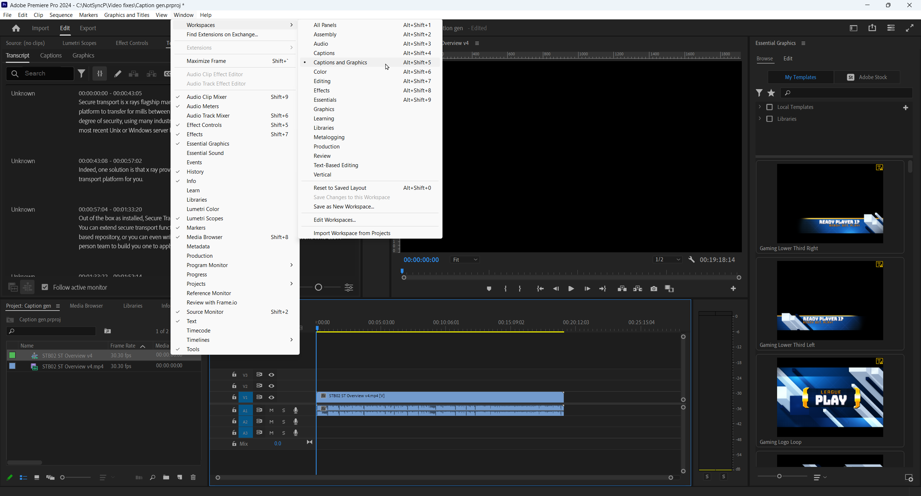
2
Open a project in Premier. Import a video and add it to the timeline.
Click Window —> Workspaces —> Captions and Graphics.
Click the play button until transcript appears
3

Slide 4
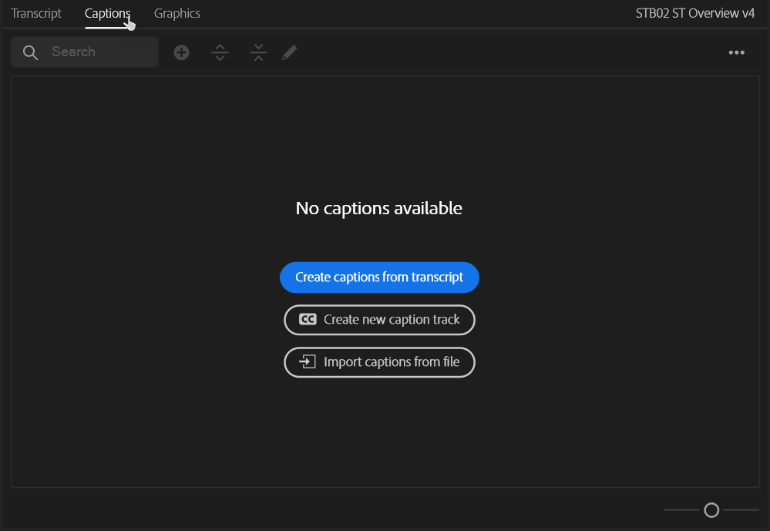
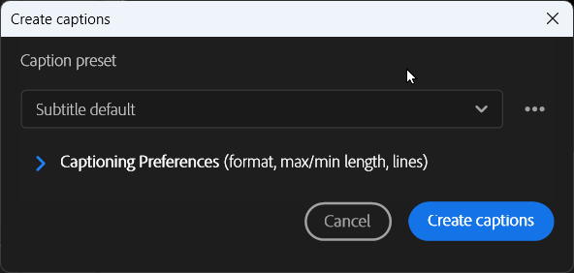
4
4. Select the Captions tab, then click Create captions from transcript
5. Click Create captions
5

Slide 5
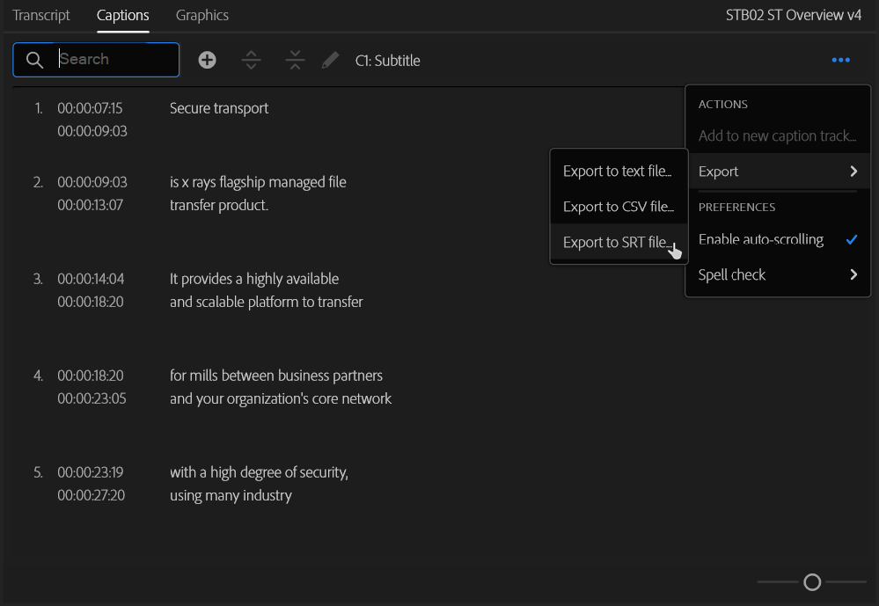
6. From this screen, you can edit your captions. Click play on the timeline to advanced automatically. Double click a line to get into edit mode, press tab when completed. It is best to edit on the Captions tab, not the transcript tab
7. Once created, click the 3 dots top right —> Export —> Export to SRT file. Navigate to deliverable folder, add captions folder and save to this location
6
7

Slide 6
Create .vtt from MS Streams
How-To

Slide 7
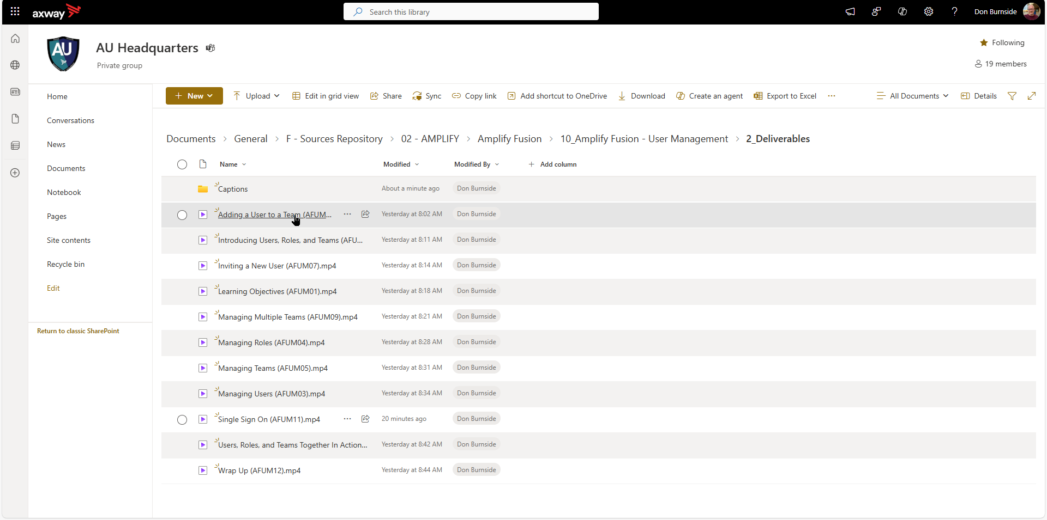
1
Open video from
OneDrive

Slide 8
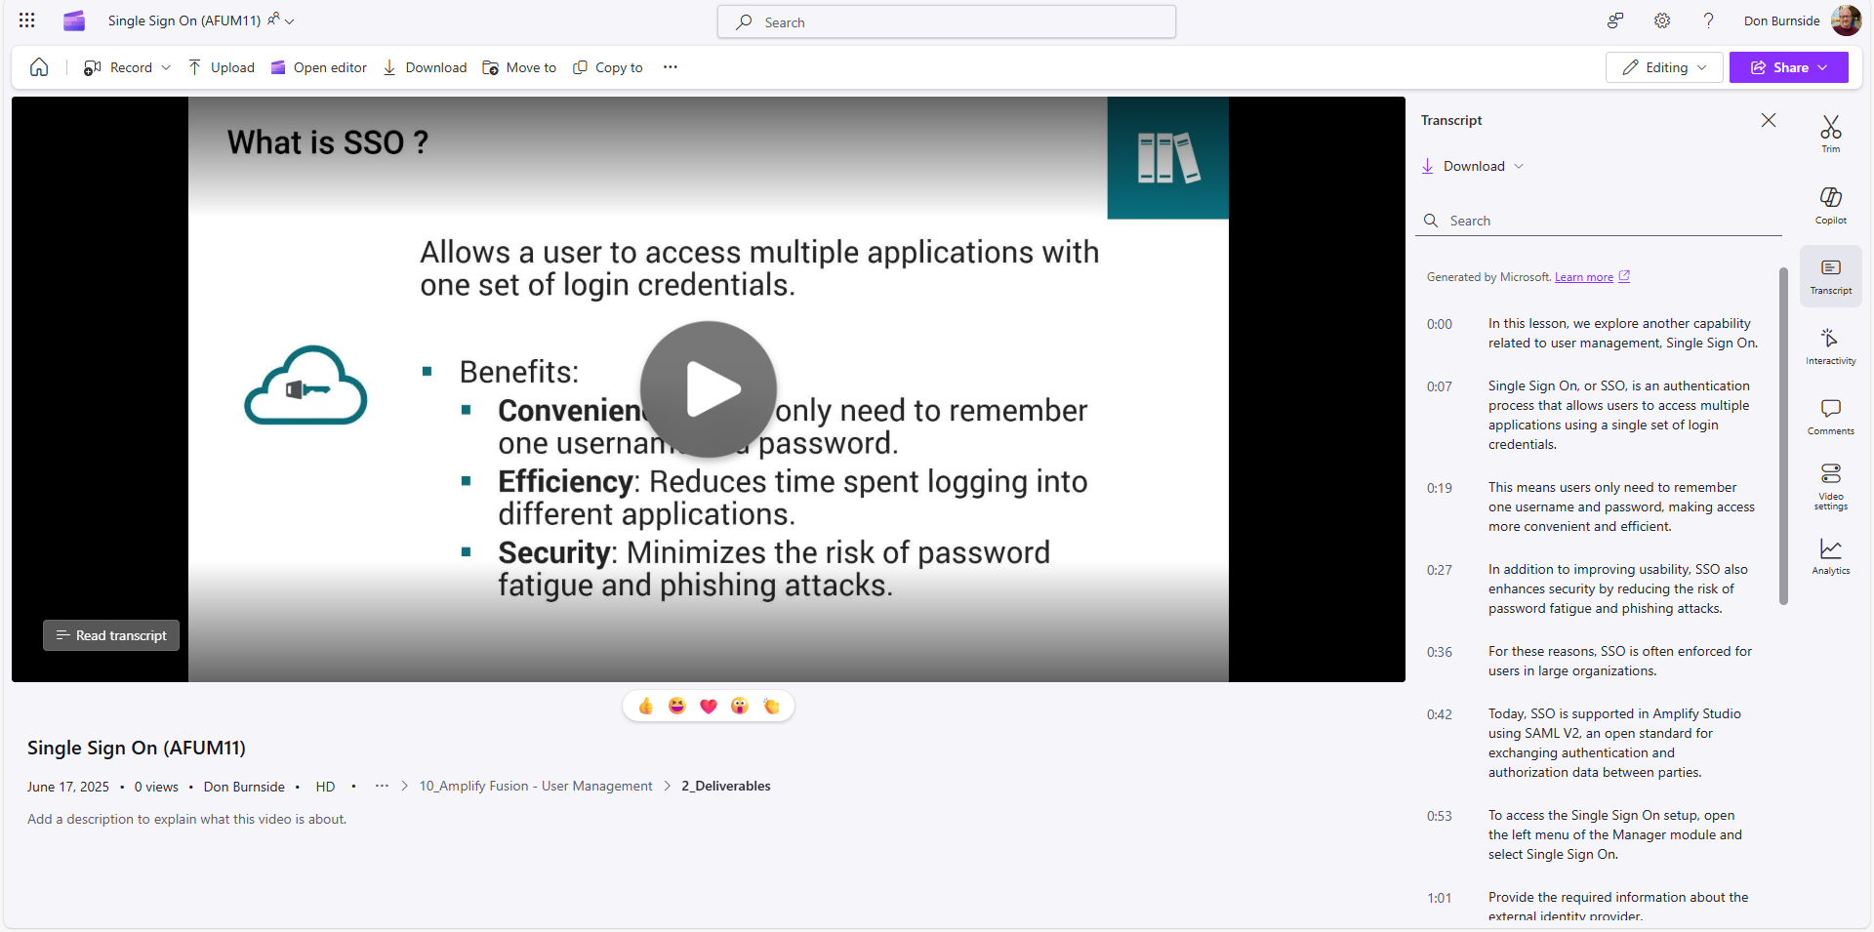
2
Click Transcript

Slide 9
3
Click Download

Slide 10

3
Click Download, choose
Download as .vtt

Slide 11
Edit VTT
How-To

Slide 12
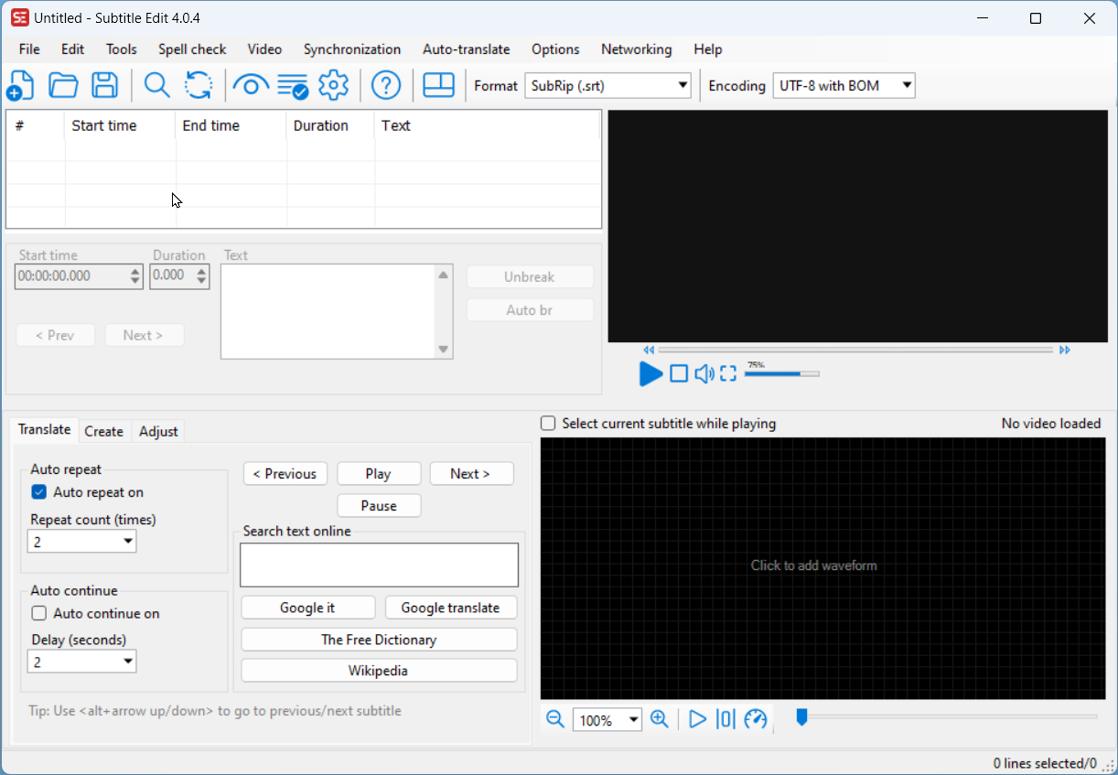
1. Open Subtitle Edit (CTRL+click to download)
1

Slide 13
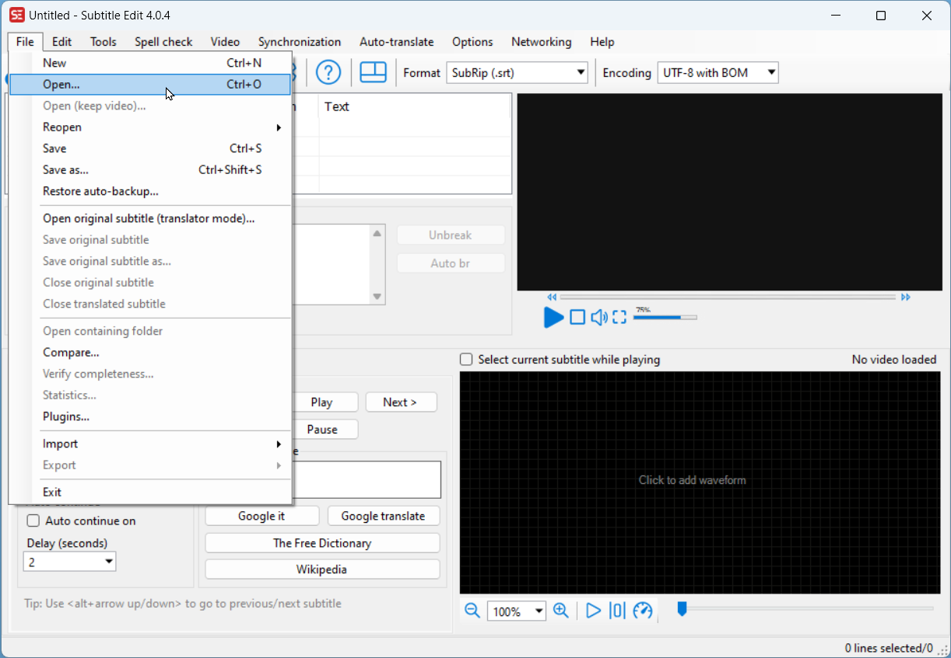
2
2. Click File —> Open. Navigate to location of your .srt or .vtt file and select it

Slide 14
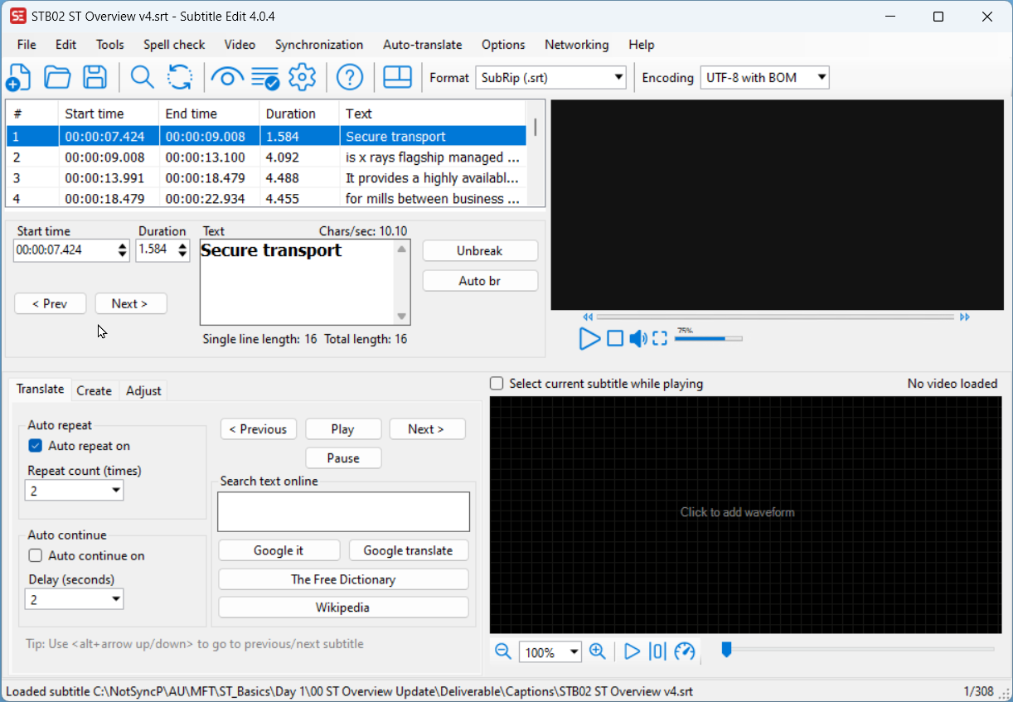
3. You will see the captions appear. You can edit here if needed.
3

Slide 15
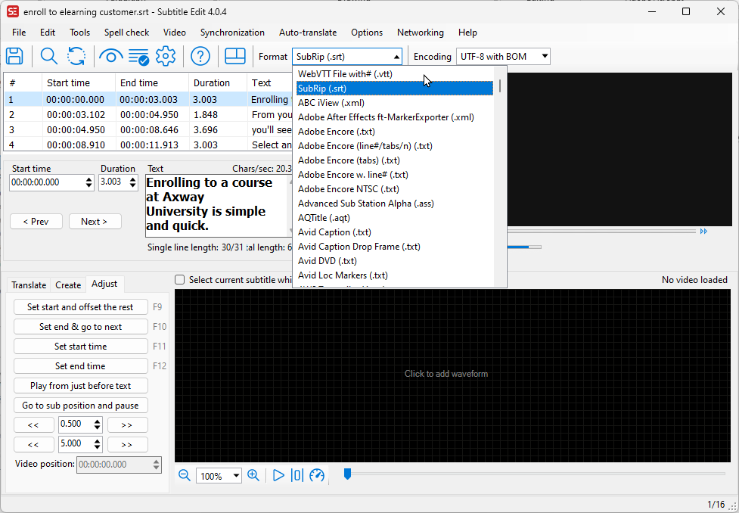
4
4. From the drop down, select WebVTT File at the top

Slide 16
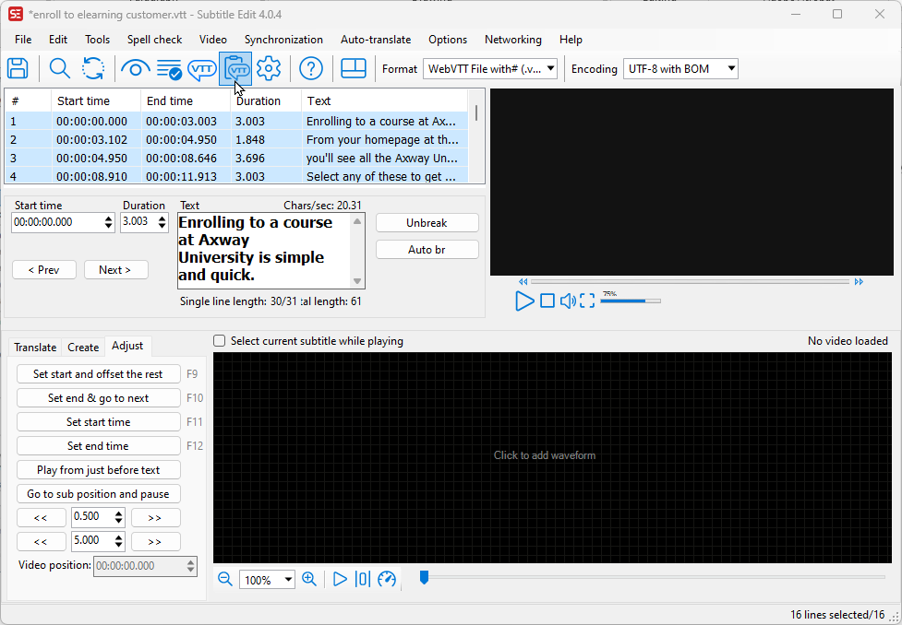
5
5. Press CTRL+A to select all of the lines, then click the VTT on a clipboard for WebVTT Properties

Slide 17
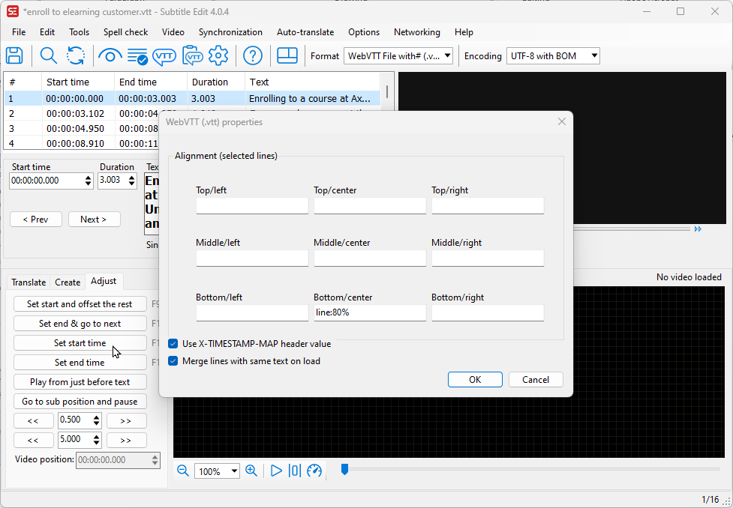
6. Add line:80% in the bottom center box, then click ok.
This only has to be done once. The app will remember for future edits.
6

Slide 18
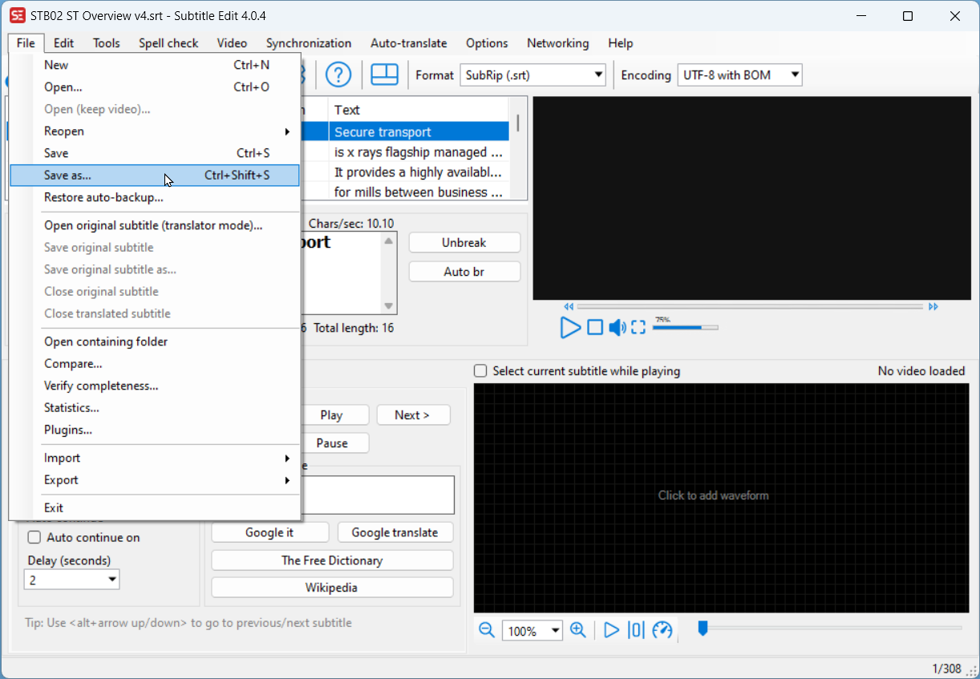
7
7. Click File —> Save as

Slide 19
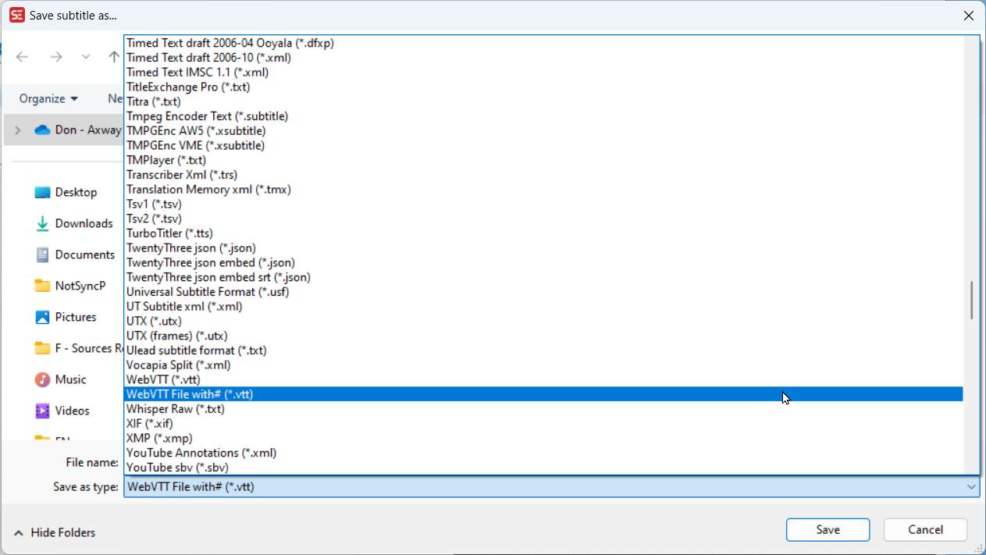
8. Select WebVTT from Save as type dialog box. Save in \captions folder
8

Slide 20
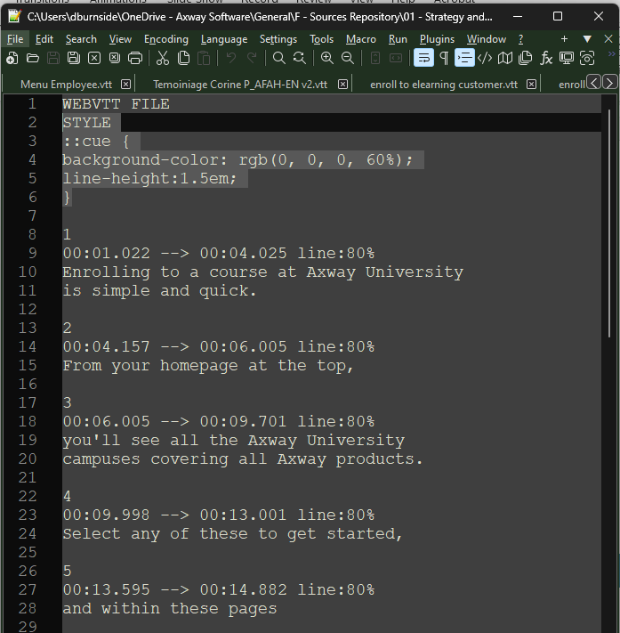
9. Open the .vtt file in a text editor. Copy the code below and paste it at the 2nd line position, directly below WEBVTT FILE. Once done, save the file (CMD/CTRL + S).
This code sets the background color and adjusts the line height for better readability.
You can copy the code block below. If it causes errors in your editor, you can copy from this text file instead.
9
STYLE
::cue {
background-color: rgb(0, 0, 0, 60%);
line-height:1.5em;
}
NOTE: do not attempt to add further CSS to this document. Please discuss with DnD if further styling changes are required

Slide 21
Upload VTT to Docebo
How-To

Slide 22
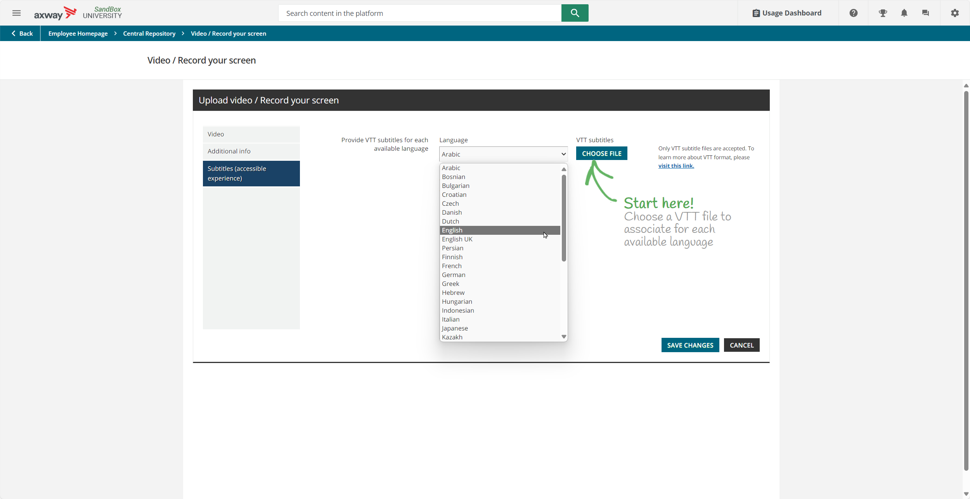
In Docebo, navigate to the Central Repository, search for the TM that needs captions and edit the TM.
Go to the Subtitles tab
Select the Language FIRST!
Click Choose file, select the .vtt file you edited
Click Save Changes
1

Slide 23
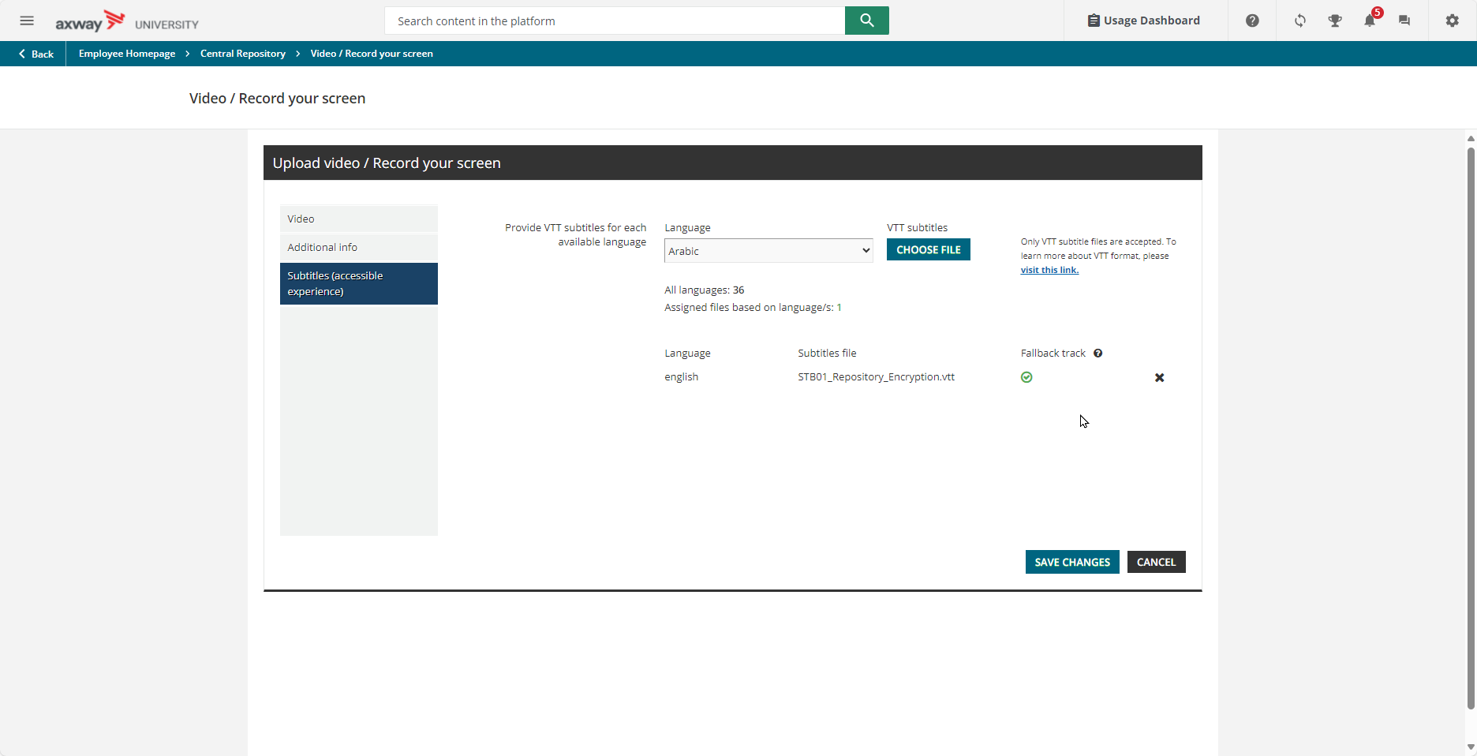
1
If further captions are available, repeat the process of selecting the language, then upload the corresponding .vtt file.
If changes are needed (wrong language selection, for example), from this screen, click the X on the line to delete that caption, then repeat to upload again

